Slide 1

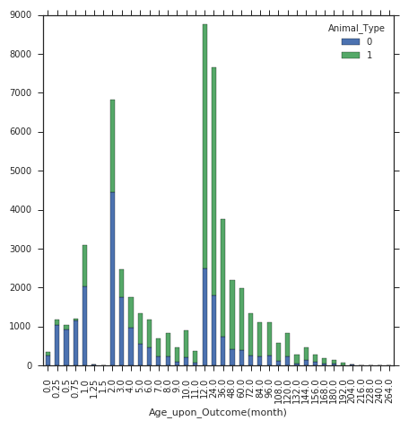
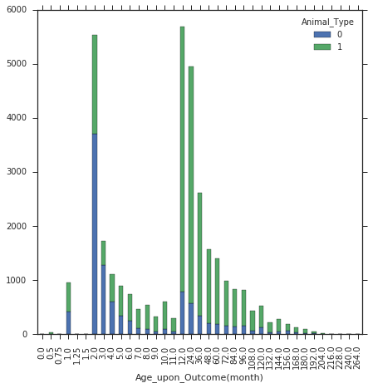
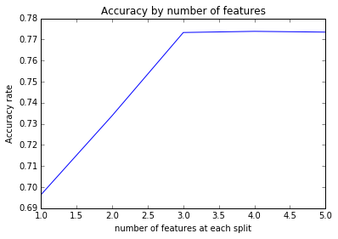

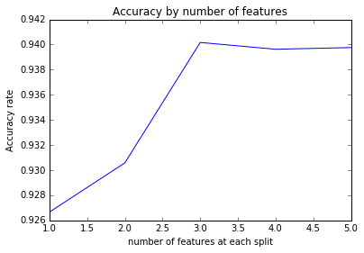
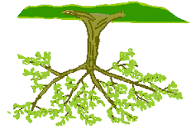
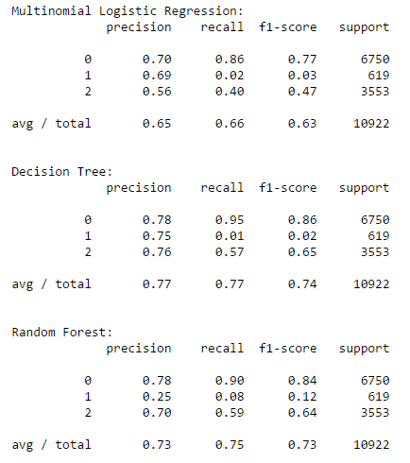
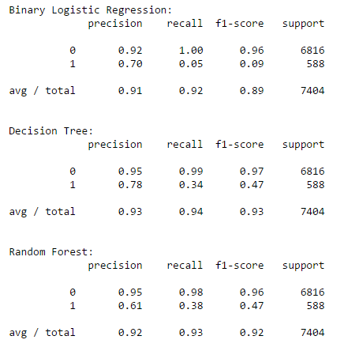


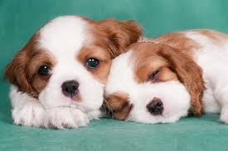

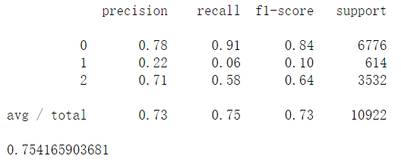

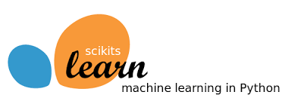
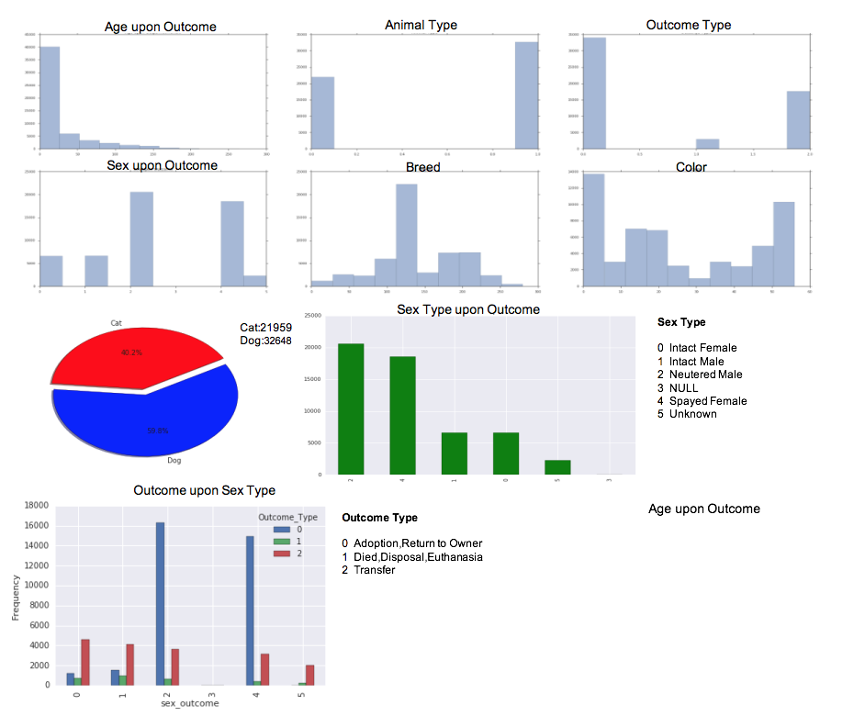

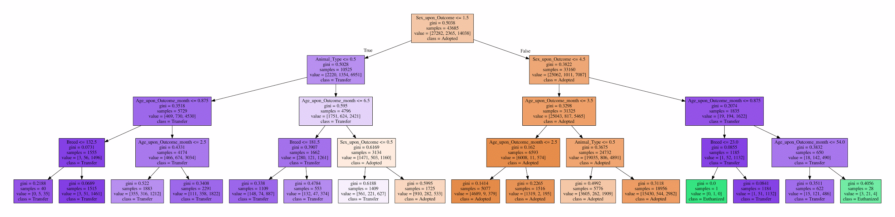
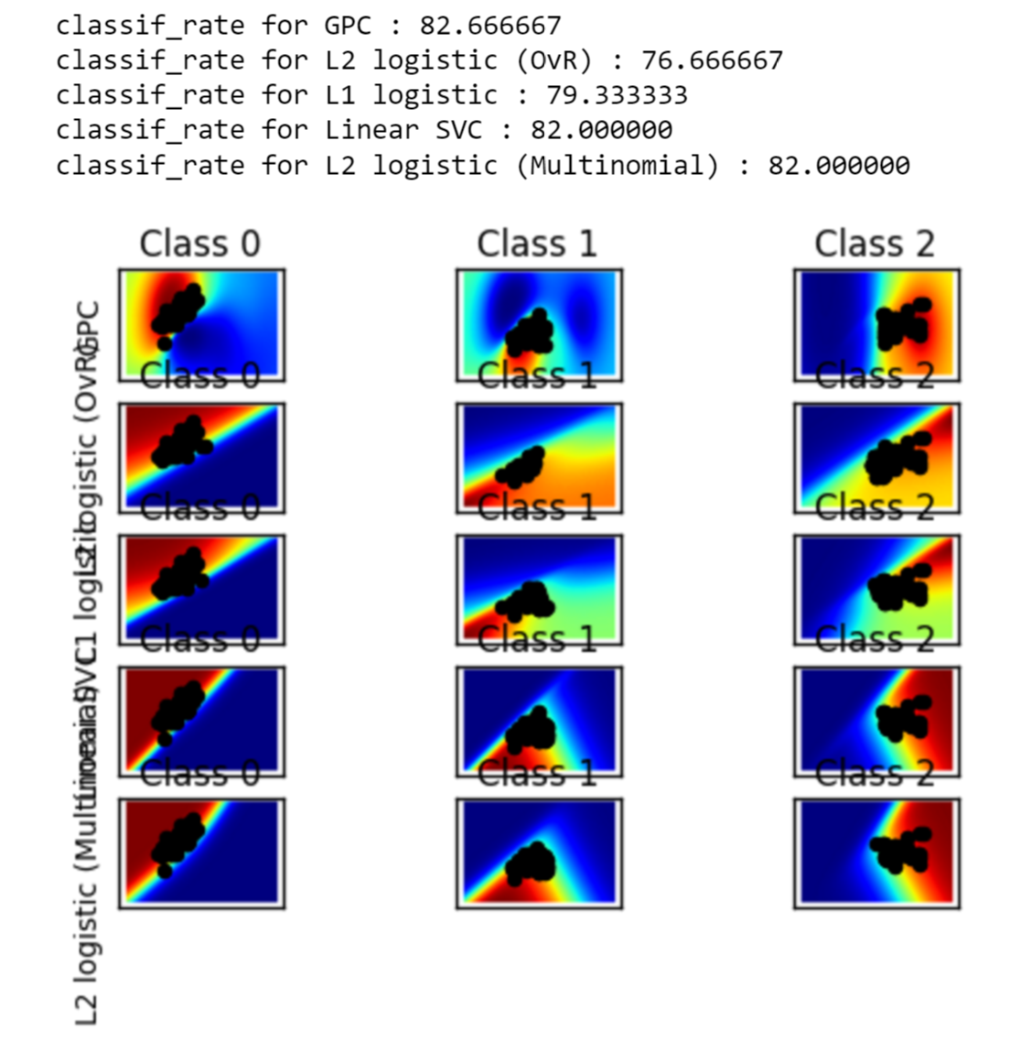
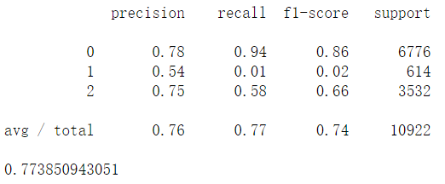
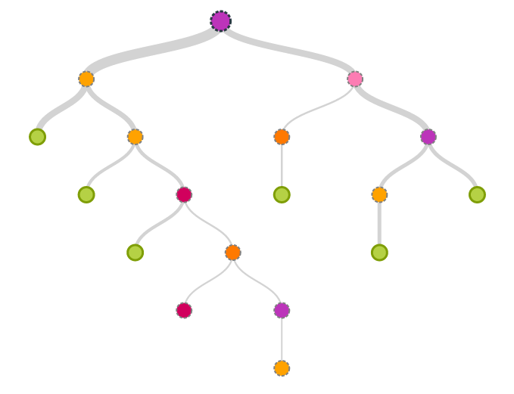
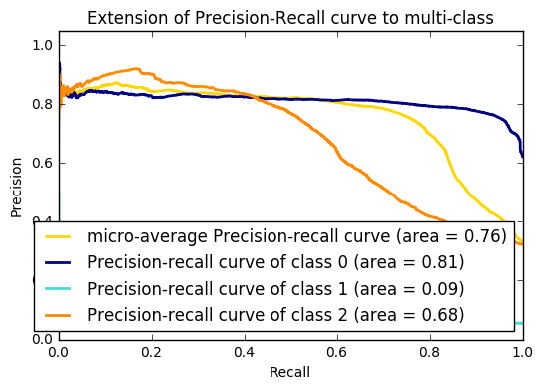
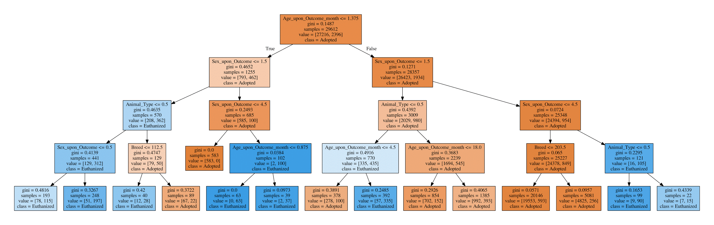

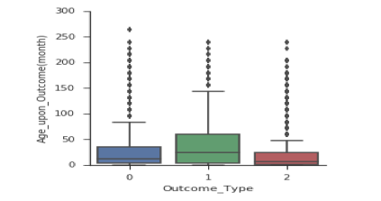
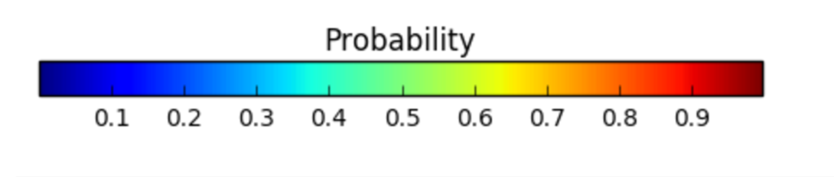

Shelter Animal Outcome Predicting
Hanchen Huang, Xiaotong Li, Zichao Wang, Qiyao Wu, Xuan Han
Project Description
Data Distribution
Logistic Regression: Two Types Class
Random Forest: Three Class Types
Random Forest: Two Class Types
Project Goals
The purpose of this project is to select the best model from various machine learning models such as decision tree, random forest,etc. to predict the outcome of shelter animals (Dog & Cat) based on information from Austin Animal Center Public Adoption Information.
The dependent (target) variable for this project is the animal’s outcome(Adopted, Transferring,Return to Owners, Died, Disposal or Euthanasia)
The independent variables are animal types, sex, age, breed and color.
Comparison Among Different Methods: Three Class Type
Comparison Among Different Methods: Two Class Type
Data Exploration
This dataset named “Shelter Animal Outcome Dataset” can be downloaded from Official City of Austin open data portal:
https://data.austintexas.gov/Health/Austin-Animal-Center-Outcomes/9t4d-g238
This dataset has 54076 instances with three outcomes and 37016 instances with two outcomes and 5 independent variables which were extracted from Official City of Austin dataset.
According to the graph Age_upon_outcome, most dogs in shelters are 12 months, 24 months or 2 months old. Most cats in animal shelters are 2 months, 12 months or 1 month old.
The graph above is the age distribution of animals adopted, most adopted cats are 2 months, 3 months or 12 months. Most adopted Dogs are adopted at age of 1 month, 12 months and 24 months.
KNN report
Data Distribution
Machine Learning Models
Logistic regression measures the relationship between the categorical dependent variable and one or more independent variables by estimating probabilities using a logistic function, which is the cumulative logistic distribution.
Random forests is an ensemble learning method for classification that operates by constructing a multitude of decision trees at training time and outputting the class that is the mode of the classes (classification) of the individual trees. Random decision forests correct for decision trees' habit of overfitting to their training set.
Decision Tree is a non-parametric supervised learning method used for classification and regression. The goal is to create a model that predicts the value of a target variable by learning simple decision rules inferred from the data features.
k-Nearest Neighbor(KNN) is K nearest neighbors is a simple algorithm that stores all available cases and classifies new cases based on a similarity measure.
SVC is supervised learning models with associated learning algorithms that analyze data used for classification and regression analysis (plot classification probability).
This dataset is a multi-class case, so we use “sag” to regularize the logistic regression.
Keycode: LogisticRegression(c=5,solver=’ ’, max_iter=1000, multi_class=’multinomial’, random_state=42)
Conclusions
Decision Tree: Three Class Types
After comparison the result between different Machine Learning Method, it turns out that Animal Type and Sex_upon_Outcome have more influence than other variables on whether an animal will be adopted from shelter.
In general, Dogs have a better chance to be adopted than cat.
Neutered or spayed animals are more likely to be adopted, and if also take sex into account the likelihood of adoption is as follows: Spayed Female > Neutered Male> Intact Male> Intact Female.
Age, Breed and Color have a very small effect on adoption, which is a little contradicted to our common sense.
SVC report
Decision Tree: Two Class Types

